Slide 1
Endangered & Endemic Species
Represented by: Shubham Dahiya

Slide 2
Table of Contents
What are Endangered Species?
Extinct, Vulnerable an Rare Species.
Factors affecting Endangered Species.
Top 10 Most Endangered Mammals.
Top 10 Most Endangered Plants.

Slide 3
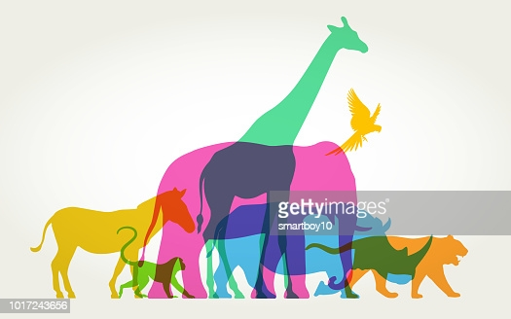
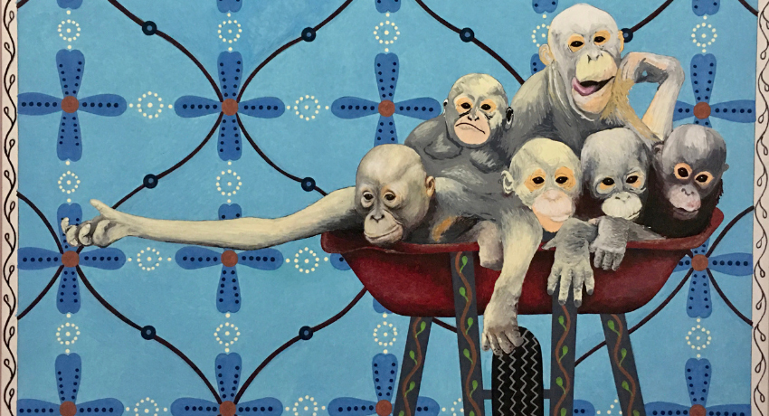
Endangered Species
Endangered Species means there’s still time.
Endangered Species are those species which are on critical level.
Endangered Species are in immediate danger of becoming extinct and needs protection to survive.

Slide 4
Extinct Species
Extinct species are those species which are no longer available.
Vulnerable Species
Vulnerable species is one whose population is facing continuous decline due to habitat destruction or over exploitation.
Rare Species
Rare species is localized within a restricted area or is thinly scattered over an extensive area. Such species are not endangered or vulnerable

Slide 5
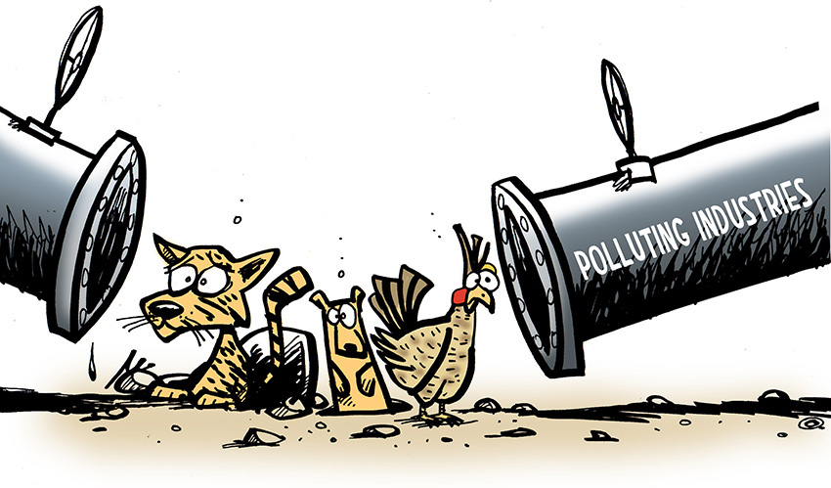
Factors Affecting Endangered Species
Habitat Degradation
Environmental Contamination
Over Harvesting
Over Hunting
Pollution
Urbanization

Slide 6
Top 10 Most Endangered Mammals
Bengal Tiger – Bengal
Asiatic Lion – Gujarat
Snow Leopard – Himachal Pradesh
Black bug – Tamil Naidu
Red Panda – Sikkim
One Horned Rhinoceros – Assam
The Nilgiri Thar – Nilgiri Hills
Kashmir Red Stag – Jammu and Kashmir
Lion Tailed Macaque – Kerala
Indian Bison - Chennai

Slide 7
Top 10 Most Endangered Plants
Milkwart – Gujarat
Bird’s foot– Gujarat
Assam catkin yew – Arunachal Pradesh
Moa – Karnataka
Ebony tree – Karnataka
Umbrella tree – Tamil Naidu
Indian mallow – Tamil Naidu
Musli –Tamil Naidu
Jeemikanda – Rajasthan
Spider wort – Madhya Pradesh

Slide 8
Ways We can help Endangered Species
Conserve Habitats
- One of the most important ways to help threatened plants and animals survive is to protect their habitats permanently in national park, nature reserves or wilderness areas.
- There they can live without too much interference from humans.

Slide 9
Make Space for Our Wildlife
- Build a birdfeeder ad establish a birdbath for the neighborhood birds.
- Plant a tree and build a birdhouse in your backyard.
Recycle, Reduce and Reuse
Plant Native Plants that are Local to the Area
- If you can plant native plants instead of non-native or introduced or introduced ones in your garden.

Slide 10
.
Control Introduced plants and Animals
- Non-native plants and animals are ones that come from outside your local area.
- controlling these foreign species is an important step in protecting wildlife.
Join an Organization
- There are many community groups working on conservation activities. Join an organization in your area and start helping today!!!

Slide 11
Thank You

